Slide 1
SM Assistant
Social Media Personal Assistant Mobile Application Requirements

Slide 2
SM Assistant
SM Assistant
LinkedIn
LinkedIn API
Linked APIs
TEXT BOX
AI Agent
Linked API Key
AI Agent
TEXT BOX
SM Assistant
SAVE
Back to Home

Slide 3
SM Assistant
SM Assistant
AI Agent
Claude AI Agent
Claude APIs
Claude AI Agent
TEXT BOX
Claude API Key
TEXT BOX
Gemini AI Agent
Groq AI Agent
SAVE
Back to Home
Back to Home

Slide 4
SM Assistant
SM Assistant
Gemini AI Agent
Groq AI Agent
Gemini APIs
Groq APIs
TEXT BOX
TEXT BOX
Gemini API Key
Groq API Key
TEXT BOX
TEXT BOX
SAVE
SAVE
Back to Home
Back to Home

Slide 5
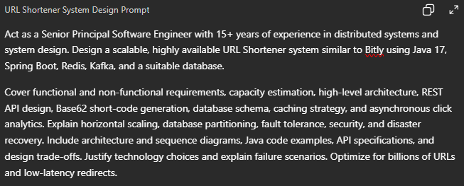
SM Assistant
SM Assistant
SM Assistant
Social Media Assistant
Prepare LinkedIn Post Prompt
Prepare LinkedIn Post Prompt
Prepare LinkedIn Post Prompt
Design a system for Short URL
Generate Technical Content
Generate Image
Generate Video
Generate Content & Image
Generate Content & Video
Design a system for Short URL
Submit
Submit
Back to Home
Back to Home

Slide 6

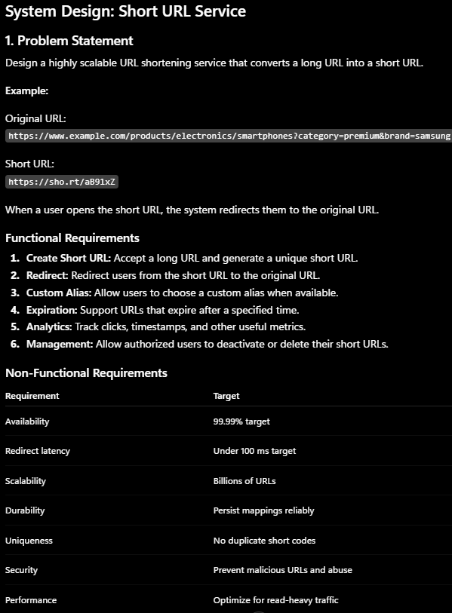
SM Assistant
SM Assistant
SM Assistant
Generate Technical Content
Generate Technical Content
Generate Technical Content
Submit
Submit
Post in LinkedIn
Submit
Back to Home
Back to Home
Back to Home

Slide 7
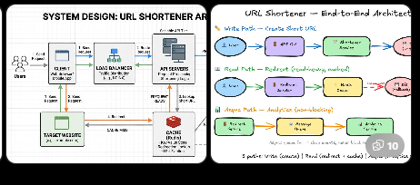
SM Assistant
SM Assistant
SM Assistant
Generate Image
Generate Image
Generate Image
Post in LinkedIn
Submit
Submit
Submit
Back to Home
Back to Home
Back to Home

Slide 8
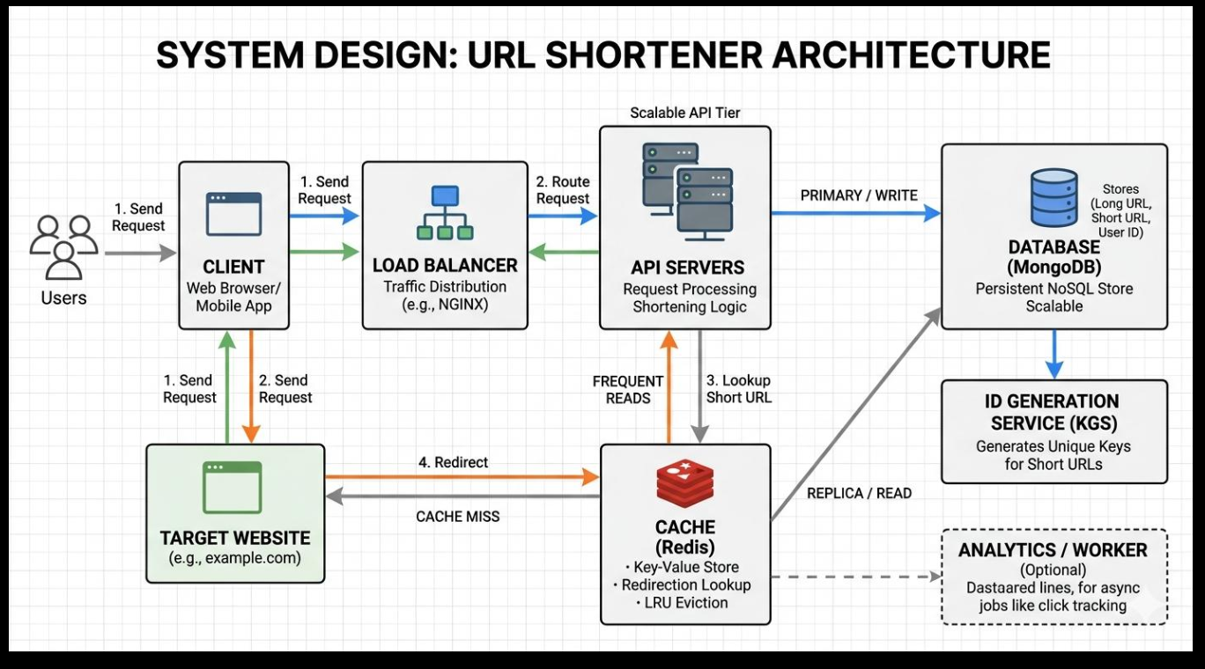
SM Assistant
Generate Image
Post in LinkedIn
Back to Home

Slide 9
SM Assistant
SM Assistant
SM Assistant
Generate Video
Generate Video
Generate Video
Post in LinkedIn
Submit
Submit
Submit
Back to Home
Back to Home
Back to Home

Slide 10
SM Assistant
SM Assistant
SM Assistant
Generate Content & Video
Generate Content & Video
Generate Content & Video
Post in LinkedIn
Submit
Submit
Submit
Back to Home
Back to Home
Back to Home

Slide 11
SM Assistant
SM Assistant
SM Assistant
Generate Content & Image
Generate Content & Image
Generate Content & Image
Post in LinkedIn
Submit
Submit
Submit
Back to Home
Back to Home
Back to Home

Slide 12
